Slide 1
Workshop Session on
Solid Fuel Combustion
or
How I stopped preaching to the CHOIR and learned to love COAL
Position paper:
Crispin Pemberton Pigott
New Dawn Engineering
Workshop on Domestic Stoves
International Conference on Domestic Use of Energy: DUE 2011,
Cape Peninsula University of Technology, Belville, 12 – 13 April 2011

Slide 2
What COAL is not
is not a dirty smoky fuel any more than paraffin is (and it is not)
does not contain ‘smoke’
does not contain carbon-monoxide (CO)
does not contain particulate matter
does not cause radiation burns or radon gas or any nuclear threat not already present in bananas (which contain Potassium 40)

Slide 3
What COAL is
it is very old biomass – the old green
it is (usually) a high energy fuel per kg
it is relatively low in O₂ compared with new biomass
it is widely used by poor people for almost all their energy needs
it is widely vilified as a ‘dirty fuel’, in fact it has been demonized as the very definition of dirty fuel

Slide 4
Why do COAL stoves smoke?
because the stove does not burn all the fuel
or all the CO
or all the smoke
because the stove was not designed to burn coal
It is the STOVE which smokes,
not the COAL!

Slide 5
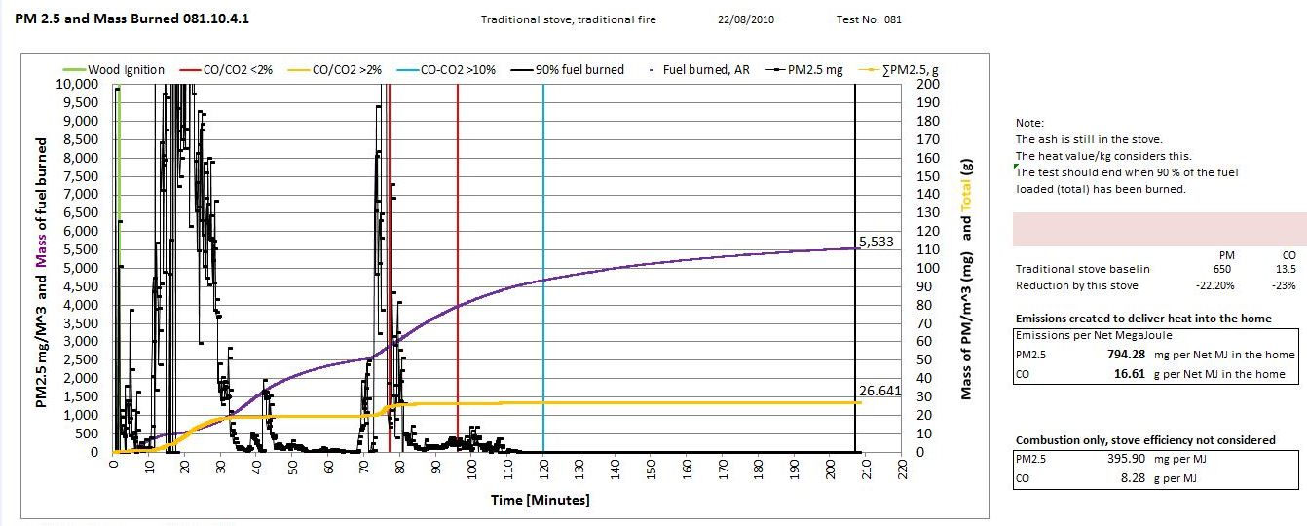
Baseline Stove Emissions of PM 2.5

Slide 6
Clean ways to burn COAL
Fluidised beds? Not really, at least no so far.
In a cast iron coal stove? Not really, so far.
Co-fired with wood? Bad experience so far.
Gasifier, yielding coke? Big energy losses.
Only three methods found so far
Top-lit Up-draft (TLUD) stoves
Bottom-lit Down-draft (BLDD) stoves
End-lit Cross-draft (ELCD) stoves

Slide 7
Why do these three methods work?
They have common elements in their design:
Only a small portion of the fuel is ignited at once
Newly evaporated volatiles are passed through
a bed of hot coke
The volatiles are cracked to make producer gas
Ash is cleared from the places where gases burn
Excess air is limited => good air:fuel ratio
Correct primary:secondary air split
(not the same as the correct air:fuel ratio)

Slide 8
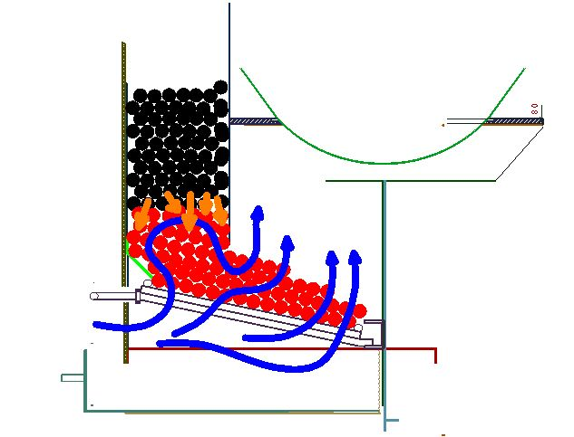
Hopper-fed cross draft stove

Slide 9
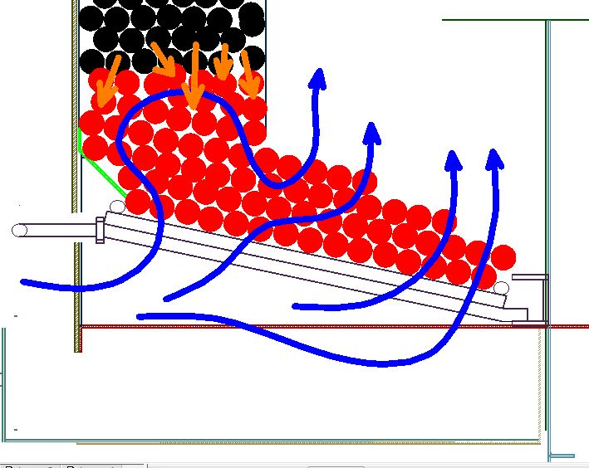
The gas path is long

Slide 10
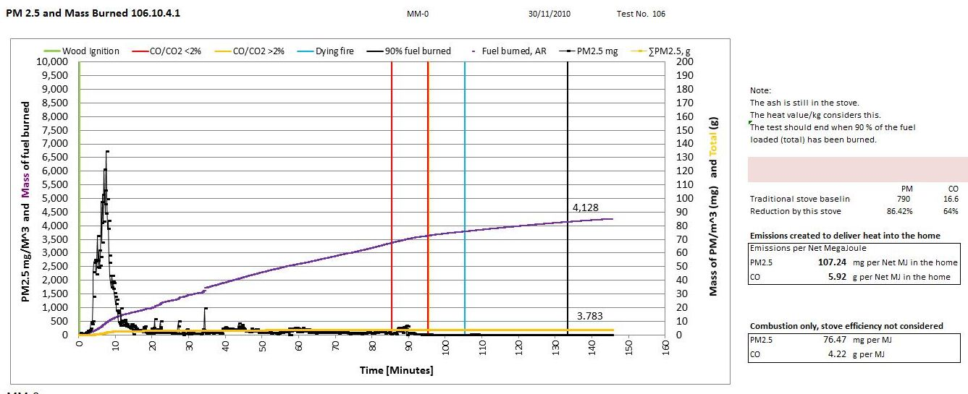
ELCD PM2.5 Reduction
PM 2.5/m³ & Mass burned
Time (minutes)

Slide 11
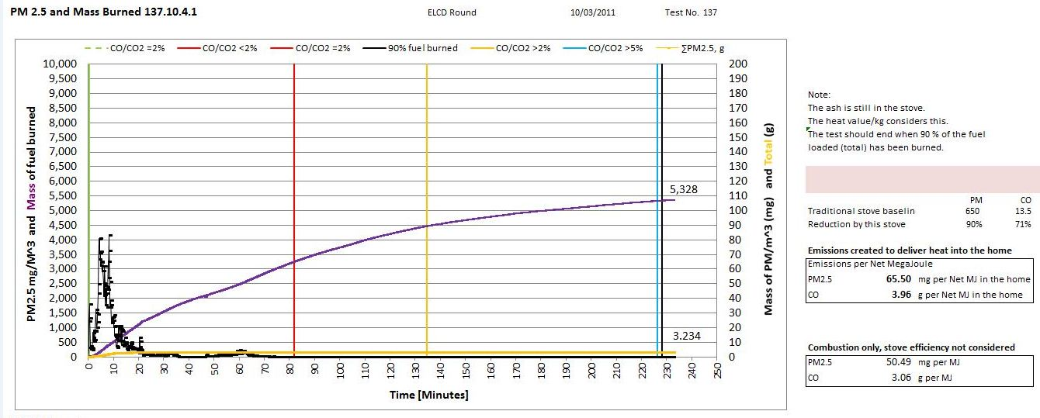
Crossdraft PM 2.5 Reduction
PM 2.5/m³ & Mass burned
Time (minutes)

Slide 12
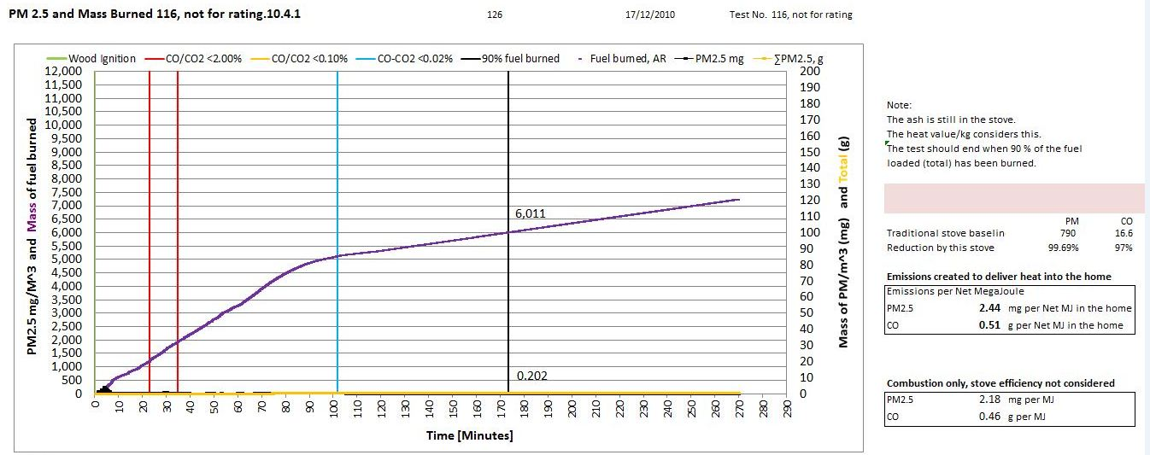
TLUD PM2.5 reduction
PM 2.5/m³ & Mass burned
Time (minutes)

Slide 13
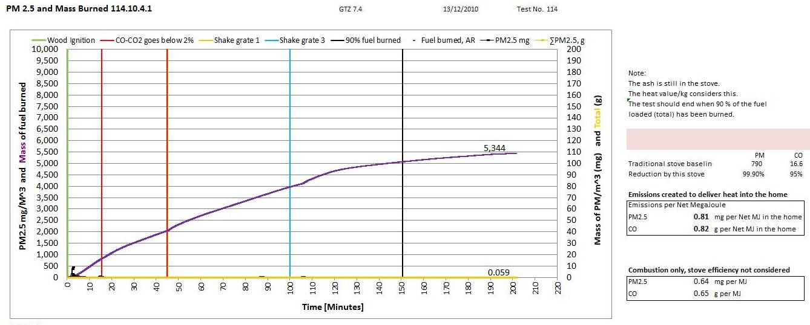
Hopper + crossdraft PM 2.5 reduction
PM 2.5/m³ & Mass burned
Time (minutes)

Slide 14
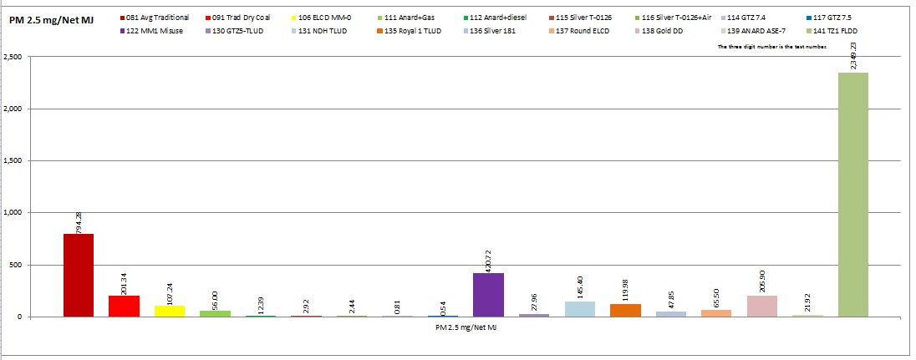
Comparison of 20 stoves PM 2.5
Official Target 2008: 30% reduction
Unofficial Target: Target: 98% reduction
Achieved March 2011: 5 successful products >98% reduction
Best: >99% (3 products)
PM 2.5 per
Net MJ
“Improved” stove
2000
Baseline
1000
Really improved!
500

